Slide 1

Empirical Comparisons, and the STL Sorts
Lecture 27
Data Structures and Abstractions

Slide 2
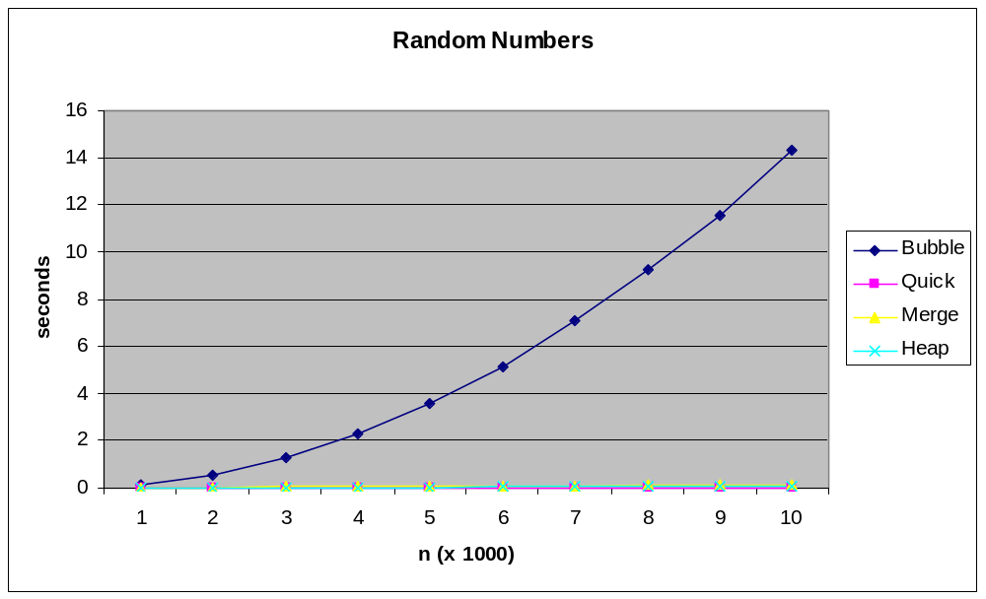
Empirical Comparison 1[1]
Notes:
[1] Results would vary depending on how powerful your machine is. Relative trends is expected to be similar.

Slide 3
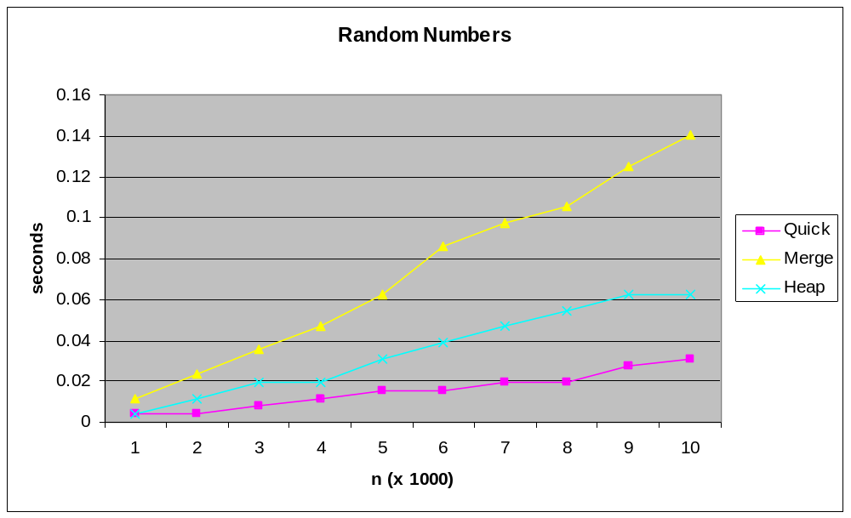
Empirical Comparison 2

Slide 4
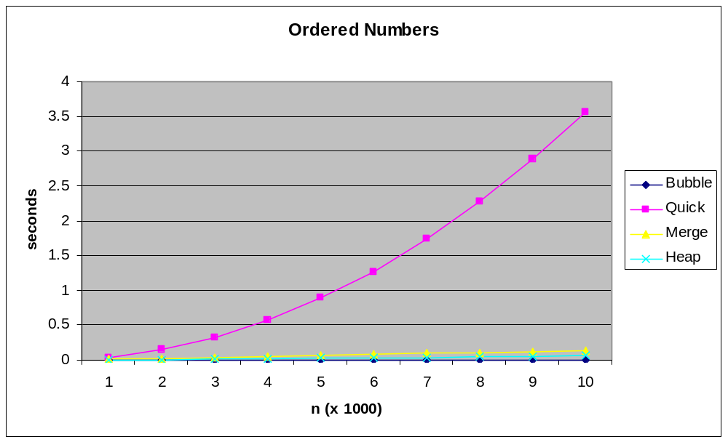
Empirical Comparison 3

Slide 5
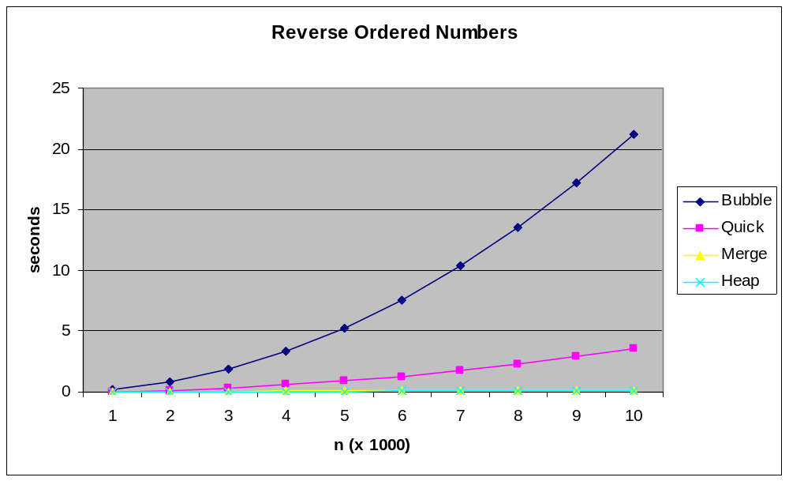
Empirical Comparison 4

Slide 6
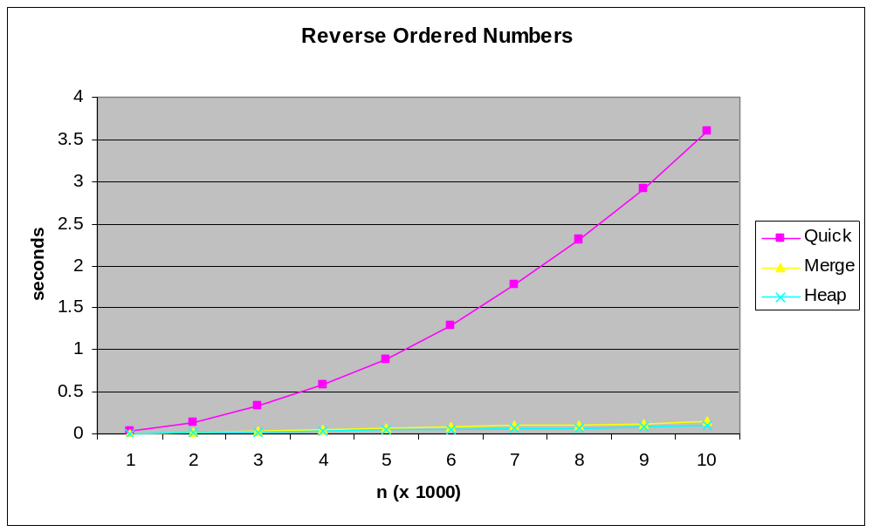
Empirical Comparison 5

Slide 7
STL Sorts
There are a number of sort routines available in the STL algorithm library, a priority queue, which acts as a heap sort, plus some templates that have sorts of their own.
sort(thing.begin(), thing.end()) is a quicksort algorithm.
stable_sort(thing.begin(), thing.end()) does a stable sort, but I could not find definitive information on the algorithm used. However it is described as being like the sort algorithm, in which case, the type of split or partitioning routine will determine stability. But see Silicon Graphics site [1] notes where it is made explicit that stable_sort uses merge sort.
pqueue<something> is a heap: put data into it and then pull it out and it is in order. [2]
These are all very, very fast indeed: much faster than the ones any particular individual can write.
This is because they have been written, reviewed, optimised etc. by multiple experts.
Notes:
[1] http://www.sgi.com/tech/stl/stable_sort.html (originally, now retired because of acquisition by HP), now hosted at http://www.martinbroadhurst.com/stl/stable_sort.html
Also see http://www.sgi.com/tech/stl/index.html (originally, now retired because of acquisition by HP), archive at http://www.martinbroadhurst.com/stl/stl_index.html
[2] You would have noticed this behavior when using a BST and in-order traversal.

Slide 8
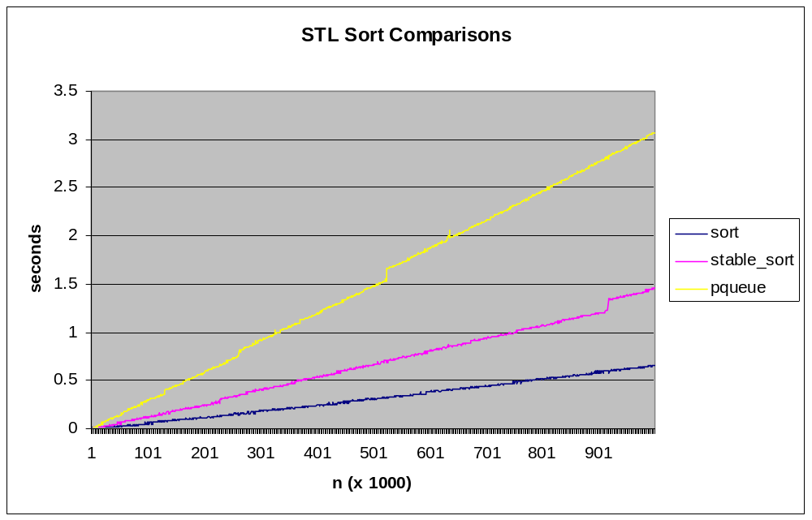
Empirical Comparison 6

Slide 9
Less Than Operator
Note that these sorts require that a less than operator (<) be available for the ‘things’ being sorted.
Therefore, if you are sorting your own objects, you must overload a less than operator within the class to which they belong.
To overload a < operator for a Circle class: [1]
  bool Circle::operator < (const Circle &other)
  {
  return (m_radius < other.m_radius);
  }
Notes:
[1] Would this approach work if you have a situation where the thing to be compared varies from application to application?
Say you have an Apple class. In one application, an apple object is “less than” another apple object because it weighs less.
In another application, it could be because it was smaller in size, or had less pips, … etc.
How would you have a comparison that is per application and the class code itself is not modified every time the application changes.
Hint: What did you have to do to get the operator>> and operator<< to become non-member and non-friend in the earlier lab exercises?

Slide 10
Readings
Textbook, chapter Standard Template Library, section on Algorithms.
Can a machine come up with a better sorting algorithm than a human?
  “Faster sorting algorithms discovered using deep reinforcement learning”
  https://www.deepmind.com/blog/alphadev-discovers-faster-sorting-algorithms
  https://www.nature.com/articles/s41586-023-06004-9

